Slide 1
Language modeling :
Language modeling is the way of determining the probability of any sequence of words. Language modeling is used in a wide variety of applications such as Speech Recognition, Spam filtering, etc. In fact, language modeling is the key aim behind the implementation of many state-of-the-art Natural Language Processing models.
N-grams are contiguous sequences of items that are collected from a sequence of text or speech corpus or almost any type of data. The n in n-grams specify the size of a number of items to consider, unigram for n =1, bigram for n = 2, and trigram for n = 3, and so on. n-gram and n-gram models are widely used in probability, communication theory, computational linguistics like statistical natural language processing), computational biology etc.

Slide 2
Methods of Language Modelings:
Two types of Language Modelings:
Statistical Language Modelings: Statistical Language Modeling, or Language Modeling, is the development of probabilistic models that are able to predict the next word in the sequence given the words that precede. Examples such as N-gram language modeling.
Neural Language Modelings: Neural network methods are achieving better results than classical methods both on standalone language models and when models are incorporated into larger models on challenging tasks like speech recognition and machine translation. A way of performing a neural language model is through word embeddings.

Slide 3

N-Grams
Probability of a sentence can be calculated by the probability of sequence of
words occurring in it.
We can use Markov assumption, that the probability of a word in a sentence
depends on the probability of the word occurring just before it.
Such a model is called first order Markov model or the bigram model.
Here, W_{n} refers to the word token corresponding to the nth word in a sequence.

Slide 4
A combination of words forms a sentence. However, such a formation is meaningful only when the words are arranged in some order. Eg: Sit I car in the
Such a sentence is not grammatically acceptable. However some perfectly grammatical sentences can be nonsensical too!
Eg: Colorless green ideas sleep furiously
One easy way to handle such unacceptable sentences is by assigning probabilities to the strings of words i.e, how likely the sentence is.
Probability of a sentence
If we consider each word occurring in its correct location as an independent event, the probability of the sentences is :
P(w(1), w(2)..., w(n-1), w(n))
Using chain rule: = P(w(1)) * P(w(2) | w(1)) * P(w(3) | w(1)w(2)) ... P(w(n) | w(1)w(2) ... w(n-1))

Slide 5
Bigrams
We can avoid this very long calculation by approximating that the probability of a given word depends only on the probability of its previous words.
This assumption is called Markov assumption and such a model is called Markov model- bigrams.
Bigrams can be generalized to the n-gram which looks at (n-1) words in the past.
A bigram is a first-order Markov model.
Therefore , P(w(1), w(2)..., w(n-1), w(n)) = P(w(2)|w(1)) P(w(3)|w(2)) ... P(w(n)|w(n-1))

Slide 6
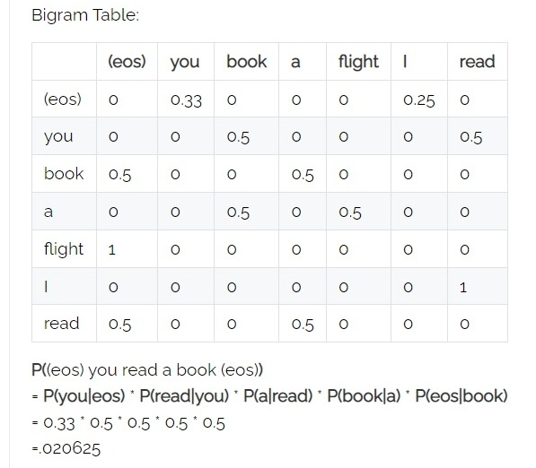
We use (eos) tag to mark the beginning and end of a sentence.
A bigram table for a given corpus can be generated and used as a lookup table for calculating probability of sentences.
Eg: Corpus - (eos) You book a flight (eos) I read a book (eos) You read (eos)

Slide 7
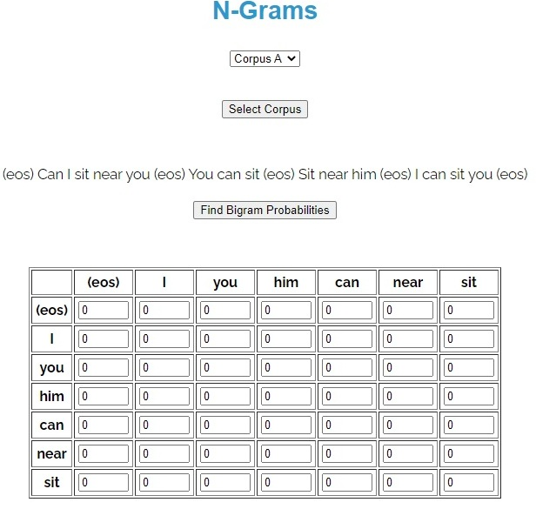

Slide 8
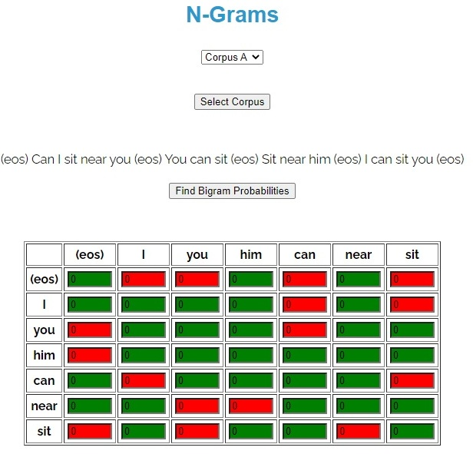

Slide 9
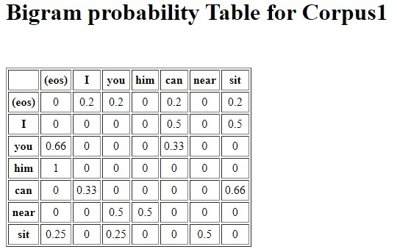

Slide 10
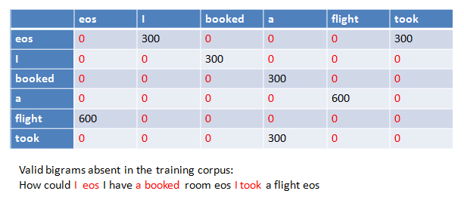
N-Grams Smoothing

Slide 11
One major problem with standard N-gram models is that they must be trained from some corpus, and because any particular training corpus is finite, some perfectly acceptable N-grams are bound to be missing from it.
We can see that bigram matrix for any given training corpus is sparse. There are large number of cases with zero probabilty bigrams and that should really have some non-zero probability.
This method tend to underestimate the probability of strings that happen not to have occurred nearby in their training corpus.
There are some techniques that can be used for assigning a non-zero probabilty to these 'zero probability bigrams'. This task of reevaluating some of the zero-probability and low-probabilty N-grams, and assigning them non-zero values, is called smoothing.

Slide 12
This task of reevaluating some of the zero-probability and low-probability N-grams, and assigning them non-zero values, is called smoothing.
Some of the techniques are:
Add-One Smoothing,
Witten-Bell Discounting,
Good-Turing Discounting.
Add-One Smoothing
In Add-One smoothing, we add one to all the bigram counts before normalizing them into probabilities. This is called add-one smoothing.

Slide 13
Application on unigrams
The unsmoothed maximum likelihood estimate of the unigram probability can be computed by dividing the count of the word by the total number of word tokens N.
P(w_{x}) = c(w_{x})/sum_{i}{c(w_{i})} = c(w_{x})/N
Let there be an adjusted count c. c_{i} = (c _{i}+1 * N/(N+V)) where where V is the total number of word types in the language.
Now, probabilities can be calculated by normalizing counts by N. p_{i}* = (c _{i}+1)/(N+V)

Slide 14
Application on bigrams
Normal bigram probabilities are computed by normalizing each row of counts by the unigram count:
P(w_{n}|w_{n-1}) = C(w_{n-1}w_{n})/C(w_{n-1)}
For add-one smoothed bigram counts we need to augment the unigram count by the number of total word types in the vocabulary
V: p*(w_{n}|w_{n-1}) = ( C(w_{n-1}w_{n})+1 )/( C(w_{n-1})+V )

Slide 15
POS Tagging - Hidden Markov Model
POS tagging or part-of-speech tagging is the procedure of assigning a grammatical category like noun, verb, adjective etc. to a word.
In this process both the lexical information and the context play an important role as the same lexical form can behave differently in a different context.
For example the word "Park" can have two different lexical categories based on the context.
The boy is playing in the park. ('Park' is Noun)
Park the car. ('Park' is Verb)

Slide 16
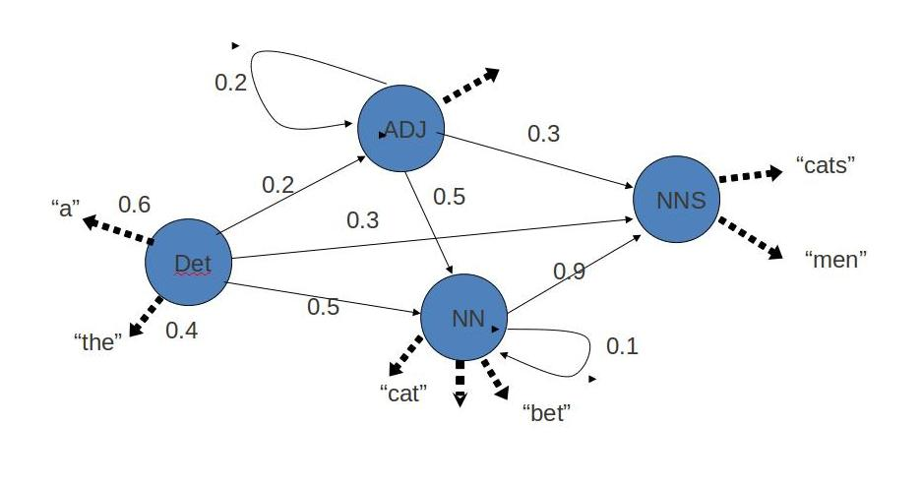

Slide 17
Assigning part of speech to words by hand is a common exercise one can find in an elementary grammar class.
But here we wish to build an automated tool which can assign the appropriate part-of-speech tag to the words of a given sentence. One can think of creating hand crafted rules by observing patterns in the language, but this would limit the system's performance to the quality and number of patterns identified by the rule crafter.
Thus, this approach is not practically adopted for building POS Tagger. Instead, a large corpus annotated with correct POS tags for each word is given to the computer and algorithms then learn the patterns automatically from the data and store them in form of a trained model.
Later this model can be used to POS tag new sentences.

Slide 18
A Hidden Markov Model (HMM) is a statistical Markov model in which the system being modeled is assumed to be a Markov process with unobserved (hidden) states. In a regular Markov model the state is directly visible to the observer, and therefore the state transition probabilities are the only parameters. In a hidden Markov model, the state is not directly visible, but output, dependent on the state, is visible.
Hidden Markov Model has two important components-
1)Transition Probabilities: The one-step transition probability is the probability of transitioning from one state to another in a single step.
2)Emission Probabilties: : The output probabilities for an observation from state. Emission probabilities B = { b_{i,k} = b_{i}(o_{k}) = P(o_{k} | q_{i}) }, where o_{k} is an Observation. Informally, B is the probability that the output is o_{k} given that the current state is q_{i}

Slide 19
For POS tagging, it is assumed that POS are generated as random process, and each process randomly generates a word.
Hence, transition matrix denotes the transition probability from one POS to another and emission matrix denotes the probability that a given word can have a particular POS. Word acts as the observations.

Slide 20
Calculating the Probabilities
Consider the given corpus
EOS/eos They/pronoun cut/verb the/determiner paper/noun EOS/eos He/pronoun asked/verb for/preposition his/pronoun cut/noun. EOS/eos Put/verb the/determiner paper/noun in/preposition the/determiner cut/noun EOS/eos

Slide 21
Calculating Emission Probability Matrix
Count the no. of times a specific word occus with a specific POS tag in the corpus. Here, say for "cut“
count(cut,verb)=1
count(cut,noun)=2
count(cut,determiner)=0
and so on zero for other tags too.
count(cut) = total count of cut = 3
Now, calculating the probability Probability to be filled in the matrix cell at the intersection of cut and verb
P(cut/verb)=count(cut,verb)/count(cut)=1/3=0.33
Similarly, Probability to be filled in the cell at he intersection of cut and determiner
P(cut/determiner)=count(cut,determiner)/count(cut)=0/3=0
Calculate for P(cut/noun)?

Slide 22
Calculating Transition Probability Matrix
Count the no. of times a specific tag comes after other POS tags in the corpus. Here, say for "determiner“
count(verb,determiner)=2
count(preposition,determiner)=1
count(determiner,determiner)=0
count(eos,determiner)=0
count(noun,determiner)=0
and so on zero for other tags too.
count(determiner) = total count of tag 'determiner' = 3
Now, calculating the probability Probability to be filled in the cell at he intersection of determiner(in the column) and verb(in the row)
P(determiner/verb)=count(verb,determiner)/count(determiner)=2/3=0.66 Similarly,
Probability to be filled in the cell at he intersection of determiner(in the column) and noun(in the row)
P(determiner/noun)=count(noun,determiner)/count(determiner)=0/3=0
Repeat the same for all the tags

